Slide 1
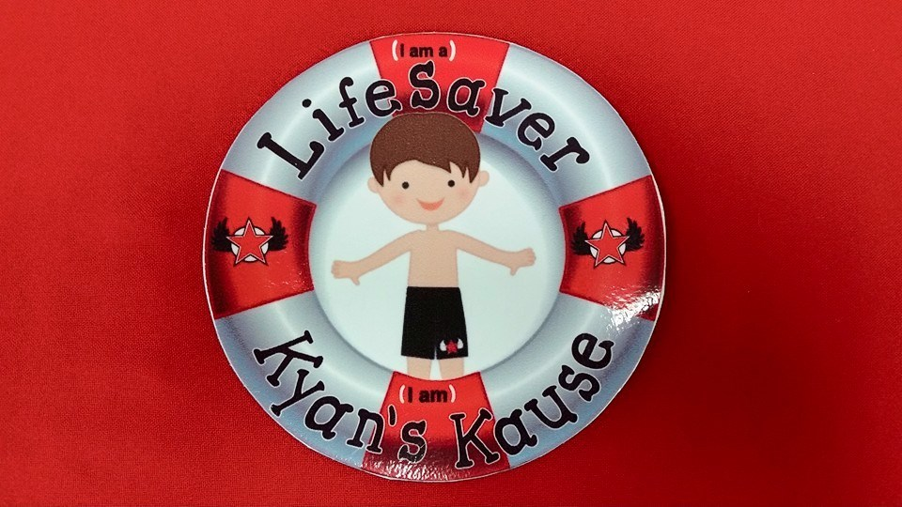
Koins for the Kause
This week we will be competing against all Bridgepreps in a Penny Wars for a Kause.
Proceeds will help augment the Kindergarten swimming curriculum, lessons and transportation for our Bridgeprep Students from all South Florida campuses.

